Slide 1
SMART ESSAY GRADER
Members name

Slide 2
Problem Description
Automated Essay Grading with feedback

Slide 3
Related Work
Most of the work done in this area is predicting the score of the essay with different ways of using word vectors and ML model.

Slide 4
Methodologies and technologies used
Data processing
Training Glove vectors
Creating multidimensional structure of essay dataset by dividing the essays into chunks
Training the dataset using LSTM and Feed forward Neural Networks pipeline

Slide 5
ASAP DATASET
ASAP – AUTOMATED STUDENT ASSESMENT PRIZE
13,000 graded student essays written by 7th-10th grade students across 8 different prompt provided by Hewlett Foundation on Kaggle
Essay are between 150 -550 words.

Slide 6
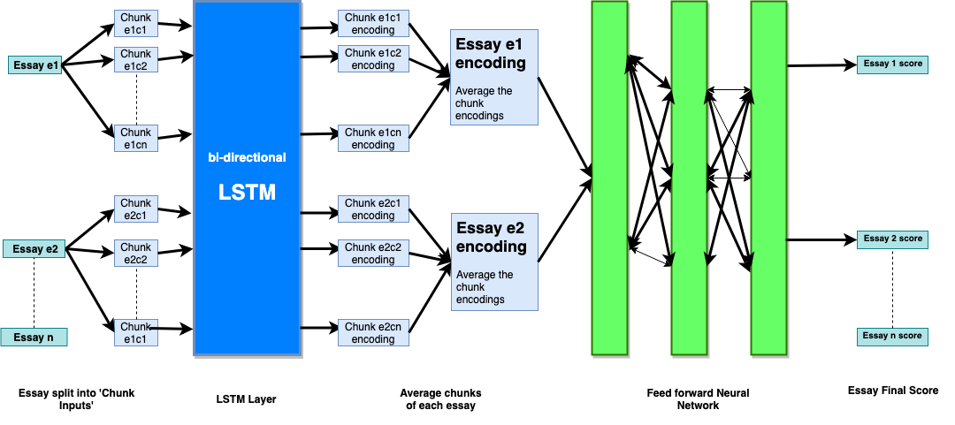
Our model

Slide 7
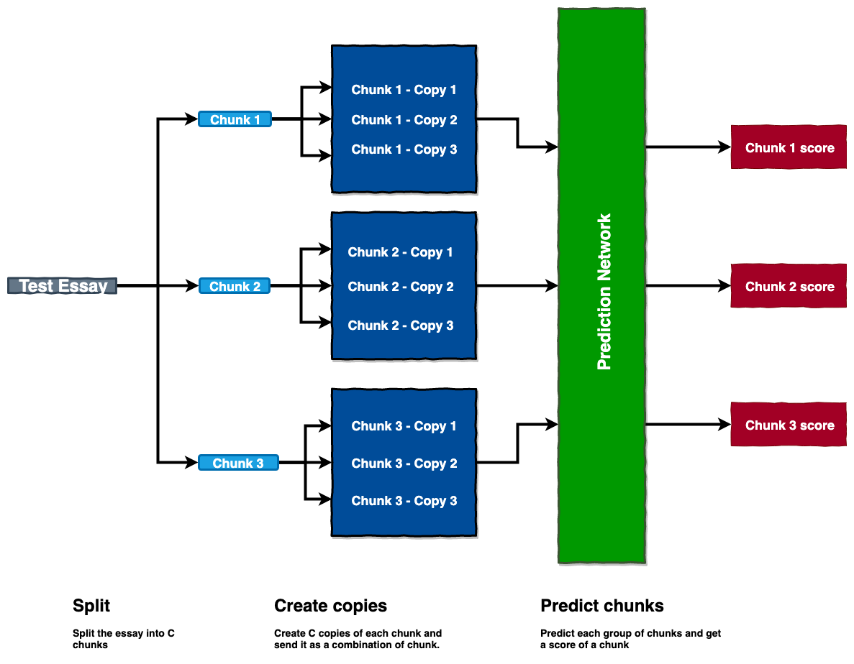
Chunk Prediction

Slide 8
Results
Word embedding | LSTM | GRU | RNN
Glove vectors | 0.1639 | 0.17119 | 0.1839
Word2vec | 0.1692 | 0.17851 | 0.1851
Notes:
After the hypertuning the parameters using cross validatin set and runing on the test set, we got the results like…

Slide 9
FUTURE WORK

Slide 11
Create feature by incorporating spelling score using Pyenchant to handle misspelled words
Additionally, exploring the use of convolutional layers working in tandem with the highway network
See how Character level embeddings affect the accuracy of the model and handle misspelled words
Notes:
2) Its something worth exploring in the future

